Slide 1
Elsternwick Park North Redevelopment
Ian Jensen-Muir
East Brighton Vampires Junior FC
President

Slide 2
East Brighton Vampires
723 registered players
plus a further 170+ kids at East Brighton Auskick
29 teams
26 clubs in the league – so all kids benefit from the use effectively doubling the number of players using the ovals
local bayside children
Aligned with the Elsternwick Auskick Centre
A further 266 kids Including 31 girls
SM AFL region had a growth in Girls participation of 61% (Total Victoria girls growth was 30%)
Traditionally age groups 8-13 play matches at Elsternwick Park Oval No.2
At least 5 teams train at the Elsternwick Park Oval No. 2
2 under 8 teams came predominantly from Elsternwick Primary school and train at the oval as it is walking distance from school
Current use of Elsternwick Oval has been reduced due to safety concerns caused by the lack of maintenance. Use will resume once corrected.

Slide 3
Why Organised Team Sport?
Team Sports provide:
Positive social interaction
Friendships and camaraderie
a sense of belonging/team membership
Children who play team sports are less likely to feel isolated.
team goal-setting skills
Opportunity to develop Leadership skills
respect for team mates/ opponents/officials
kids with important lessons on personal values.
encourage parents to become active with their kids.
friendship and camaraderie
cooperation and teamwork skills
appreciation of different abilities
self-esteem and self concept
self-discipline, patience and persistence
Develop resilience :
help kids deal with winning and losing
through sharing positive and negative experiences.
Develop physical skills
Sport and being active is very relevant for kids:
Childhood obesity has never been more of an issue
Draw of the second screen is ever increasing
Team sports ensure that kids get out and get active
Ross Morrison - NSW Department of Education and Communities

Slide 4
Elsternwick Park Nth redevelopment
The sporting community at Elsternwick park require the continued provision of a second oval at the location, suitable for cricket and football of all ages
Provision of gender neutral change rooms as female participation in AFL and cricket is growing significantly
Located near the other ovals to be more efficient in the maintenance, up keep and facilities utilising much of the same equipment
Small storage area for equipment and medical supplies
Appropriate lighting for training, as during winter light diminishes by 5pm
Flood mitigation is also an important consideration for the development as are appropriate pathways for bikes and pedestrians
EBVJFC support option 2
Access to all ovals is available to the community when organised sport is not using the ovals.
The ovals are only allocated between 25-30 hours to sport or 18% leaving the remaining time to be used by the community for other recreation purposes.

Slide 5
Local Community Sport is well supported
Vampires are all from the local community with
33% Brighton
30% Brighton East
10% coming from Elsternwick, Elwood and St Kilda

Slide 6
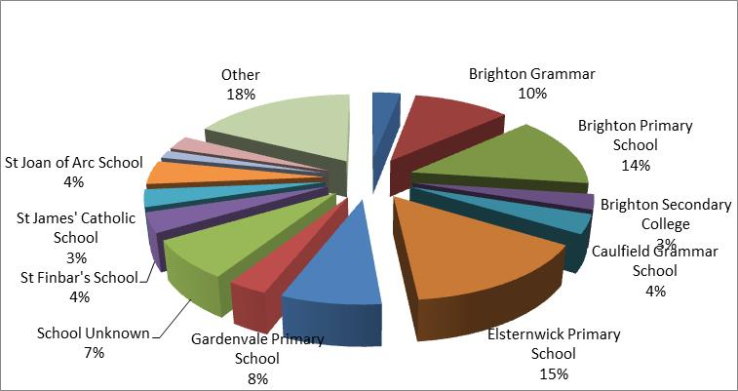
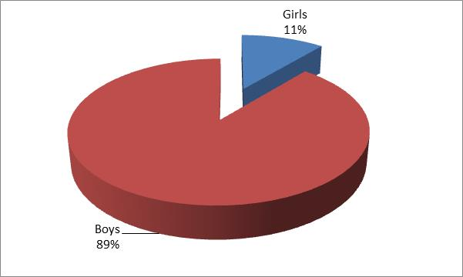
School and Gender
15 % of the Vampires are from Elsternwick Primary
The vampires single biggest represented school
Ability to walk to training and matches
11% are Girls but this number is growing significantly in the South Metro JFL growth 61%
Ongoing growth requires more ovals not less to provide the girls more opportunities
Schools also use the ovals for their physical education programs
Elsternwick PS
Gardenvale PS

